Slide 1


MAHENDRA ENGINEERING COLLEGE (AUTONOMOUS) Department of Computer Science and engineering
STUDENT DATABASE MANAGEMENT SYSTEM USING PHP
3RD REVIEW – DATE: 09.12.2021
Prepared By:
Guided By:
Bharathwaj J (Reg.No.: 181031016) Dr.M.Kannan B.E.,M.E.,(PhD).,
Karthikeyan R (Reg.No.: 181031047) Professor & Head of the Department,
Keerthivasan K (Reg.No.: 181031052 ) Computer Science and Engineering,
Kaviraj A (Reg.No.: 181031048) Mahendra Engineering College.
BE – Final Year / VII Semester

Slide 2
TABLE OF CONTENTS:
ABSTRACT
AREA OF FOCUS
EXISTING SYSTEM
LIMITATIONS OF THE EXIXTING SYSTEM
PROPOSED SYSTEM
HARDWARE &SOFTWARE SPECIFICATIONS
SCOPE OF THE PROPOSED SYSTEM
SYSTEM ARCHITECTURE
LIST OF MODULES
MODULES DESCRIPTION
METHODOLOGY &MATERIAL USED
RESULTS & DISCUSSIONS
SNAPSHOTS OF ON RESULTS
REFRENCES

Slide 3
STUDENT DATABASE MANAGEMENT SYSTEM
A Student database management web application is software applications that enable a college to track and manage all student data, information, and progress also run its teaching and financial operations.
Statistical techniques have been applied to data like student performance, behavior, curriculum, that data was gathered from college environments
With a single scan the institute head can get all the details of the student that the school must have added in the institute management system including the attendance, fees history, classroom, roll no. & contact details.

Slide 4
ABSTRACT
Student database management system is linked to all of the student’s class performance, billing, accounts, attendance and activities.
The student data are easy to accessible at one step by scanning their unique QR code.
We are developing front end design in HTML, CSS, Javascript and PHP and back end in MySql database for store and retrieve student data.
This project work would be reduced and number of workers in each department staff also reduces as one single operator can run this web application.

Slide 5
AREA OF FOCUS
This project deals with a concept derived from Management Information System, it is a unique attempt to aid the management of information of students in a university know as Student Database Management System
A student database management system is automation of manual performance record management which enables the user to assess necessary data at any place and any time through internet.
Obtaining a college web portal should provide all data and upgrade data time to time which should also improves transparency

Slide 6
AREA OF FOCUS
The main idea of this database is that users can scan student’s QR codes via a webcam and just by scanning the QR code you can get the full profile of any student
No extra cost of hardware is required as the QR code gets scan by the webcam you have.
The use of automated student database management system in place of papers.
One system operator will be enough for deploying and maintaining data thus reduces the number of workers in the office staff.

Slide 7
EXISTING SYSTEM
In existing system has a traditional manual system to store and access student data as like as put a attendance in paper and track student records such as cultural performance, academic performance in paper.
Educational institutions need to manage huge data of students for managing college affairs systematically.
With a student database management system you neither have to worry about security risks nor have to worry about losing any physical file or confidential document.

Slide 8
EXISTING SYSTEM
Managing and securing large volumes of paper files is not an easy task as you may end up misplacing the files, or the files may fall into wrong hands.
The semester marks and mid sectional exam marks are maintained in papers.
The student cannot access his/her academic details at all time and moreover searching for his marks in those set of papers is a time consuming activity
In present system, there is no option to student to track their attendance and academic information also cultural credits.

Slide 9
LIMITATIONS OF THE EXISTING SYSTEM
The data storage is relatively difficult in papers, files and registers. The retrieval of any data like marks attendance is time consuming
Possibility of loss of data or any other malpractices
Updating of new data like mid1, marks mid2, marks, attendance of current month time to time is not possible.
Time consuming process to see student data in manual records
More number of workers dealing with the student information management.

Slide 10
PROPOSED SYSTEM
In proposed system, we first collect all student’s information and store into database.
A student database management system manages all information pertaining to students’ attendance, academic reports, curriculum details, project details, exam details, grades, achievements, accounts, and much more.
After store student’s data then we can generate an QR code for each student’s profile.
Whenever we desire to view student data and put attendance to student we just scan student QR code, the data will update automatically in database

Slide 11
ADVANTAGES OF THE PROPOSED SYSTEM
Student database management system helps you manage students’ personal records effortlessly.
It provides the security for those documents may contain sensitive information about students.
It is also cost-effective because of no use of paperwork.
User Friendly system
Reports are easily generated
Provide accurate and efficient data.

Slide 12
HARDWARE AND SOFTWARE SPECIFICATION
HARDWARE REQUIREMENTS:
Processor : Dual core processor 2.6.0 GHz
RAM : 1GB
Hard disk : 160 GB
Compact Disk : 650 MB
Keyboard : Standard keyboard
Monitor : 15 inch color monitor
SOFTWARE REQUIREMENTS:
Front End : PHP
Back End : MySQL
Platform : Windows 7

Slide 13
TECHNOLOGY USED
Database management system is one kind of system software products and the core part of database system, which carries on the unified management to the database resources, and is responsible for all request orders the users send out. It can do the scientific organization data, the perfect data storage, the highly effective data capture, convenient data maintenance
QR code or Quick Response Code, is a code that a cell phone (hence the word "quick" in the name) can read easily. A large amount of information is transmitted when the QR Code is scanned using a spacing combination as some kind of Matrix Barcode

Slide 14
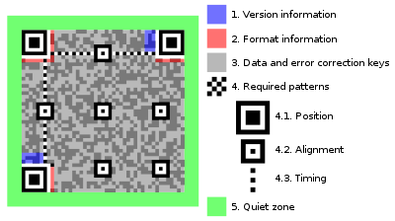
TECHNOLOGY USED
QR CODE structure

Slide 15
SCOPE OF THE PROPOSED SYSTEM:
The student database management system automates the process of data handling, thus, saving you a great deal of time.
What’s more, it also minimizes the chances of human error. The best thing about student database software is that it can be accessed from anywhere 24/7.
The software also comes with a lot of impressive features for streamlining college administration.
It keeps the digital track of student data, thus reducing paperwork. Other than personal records, a lot of documents such as admission details, student records, financial aid paperwork, etc. are created and filed by colleges on a regular basis.

Slide 16




SYSTEM ARCHITTECTURE:
Q
R
C
O
D
E Generate
Data collection
Store data
Student data
Database
Store data
Inject
Student attendance
QR code read
Student other data
Extract

Slide 17
SYSTEM FLOW DIAGRAM
Start
Login
No
Yes
Student data collection
QR code generation
Attendance register
Report generate
End

Slide 18
DFD LEVEL :0
DFD Level 0 is also called a Context Diagram. It’s a basic overview of the whole student database management system or process being analyzed or modeled.
It’s designed to be an at-a-glance view, showing the system as a single high-level process, with its relationship to external entities.
It should be easily understood by a wide audience, including stakeholders, business analysts, data analysts and developers.

Slide 19
Data gather
Administration
Data store
STUDENT DATABASE MANAGEMENT SYSTEM
Database
Faculty
Student
Data gather

Slide 20
DFD LEVEL:1
DFD Level 1 provides a more detailed breakout of pieces of the Context Level Diagram for student database management system
It will highlight the main functions carried out by the system, as break down the high-level process of the Context Diagram into its sub – processes.
A level 1 data flow diagram (DFD) is more detailed than a level 0 DFD but not as detailed as a level 2 DFD.
It breaks down the main processes into sub processes that can then be analyzed and improved on a more intimate level.

Slide 21
Administration
Faculty
Student
Login
Login
Login
Faculty details
Student Enrollment
Fees payment
Student Report
Grades & results
Student profile
Fees details
Attendance
Database

Slide 22
DFD LEVEL:2
This level 2 data flow diagram (DFD) can map out information flow, visualize an entire system of student database management system.
It is simply break processes of system, down into more detailed sub processes
Here we break processes into three steps such as admin, faculty and student
Each sub processes have an additional sub processes according to their need to function.

Slide 23
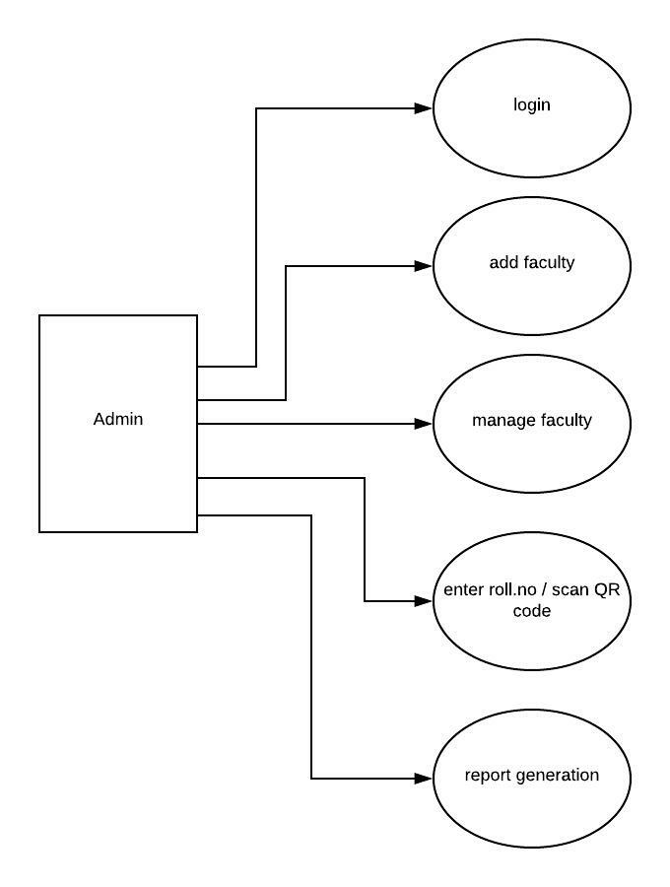
Administration

Slide 24
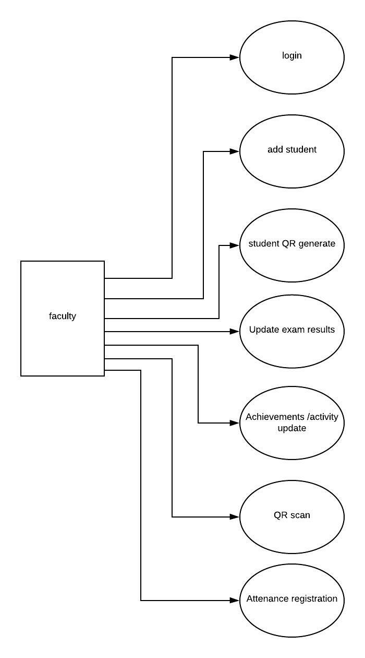
Faculty

Slide 25
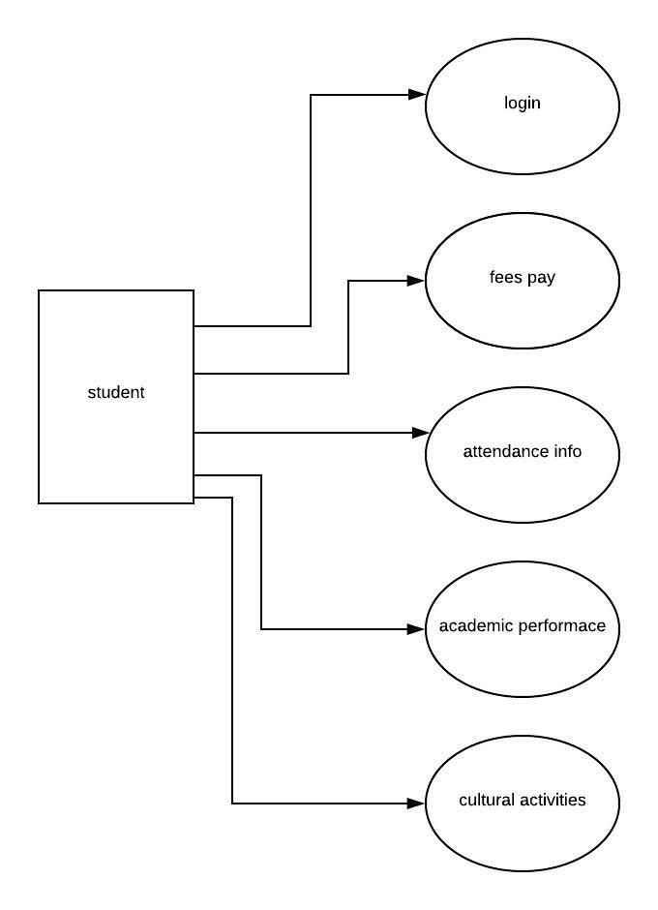
Student

Slide 26
LIST OF MODULES:
Student enrollment
QR generation
Grade and Subject Management
QR verification
Student Information Management
AES Encryption

Slide 27
MODULE DESCRIPTION

Slide 28
STUDENT ENROLLMENT
This is the process where the system takes care of the requirements provided by the student enrollees.
They will require the birth cert of the enrollees as well as their academic status that will serve as their basis if the student is new or continuing.
Enroll for academic courses and monitor the progress of students through the degree program with the flexibility to view course timetable and events in the calendar
Faculty of the college involves in student enrollment in which faculty add student’s basic information into database.

Slide 29
QR GENERATION
In practice, while QR Codes and Barcodes are identical, QR Codes provide more information since they can carry both horizontal and vertical information.
QR codes have a much greater capacity to move data, possibly due to their simplicity, which has made them extremely prevalent.
With the increase development in technology, the uses of electronic devices are also increasing and so as the various applications of QR codes
QR codes are generated to appropriate student profile which includes student’s academic information, cultural activities and attendance details.

Slide 30
GRADE AND SUBJECT MANAGEMENT
Enables students to check their academic track record time to time and improve their performance and increase their CGPA
Shows the results of every semester – the marks obtained in mid sectional exams and grades obtained in semester
The grades and results are generally updated by faculty by selecting student roll number.
Faculty updated the cultural activities of every student who participated in other extra curricular activities which are added into student’s profile.

Slide 31
QR VERIFICATION
A QR code can hide a large amount of data, numeric and alphanumeric. Thus, they have become popular all over the world.
Moreover, QR codes are widely used in telecommunication due to the increased popularity of smart phones, which typically contain software that can read QR-code images
When a staff goes to attendance page, then the application will check the QR-Codes that show in the student module.
Web cam scan the QR code and the contents of the QR code will be read by system.

Slide 32
QR VERIFICATION
If the application finds that the student is within the Student ID and Password matches the one in the database then the app will insert the student has been present in the class.
The contents of the QR code will be captured and sent back to our application.
The server checks then that the QR-Codes is correct and assigned to a user as per the users table.
In case of success, the transaction row will be deleted and the user authenticated
A PHP session is created for the user, being destroyed when the user logs off or when the browser is closed

Slide 33
STUDENT INFORMATION MANAGEMENT
According to the evaluation content of students’ work under office and departmental target responsibility system we developed improved student database management system.
The student database management application system would have functions such as browse, query, statistics, modification, report.
Each function should be refined to adapt the different demand and it gives a comprehensive look at all the data on a single screen and ensures that all essential data is highlighted.
This results in better productivity and growth with minimum effort.

Slide 34
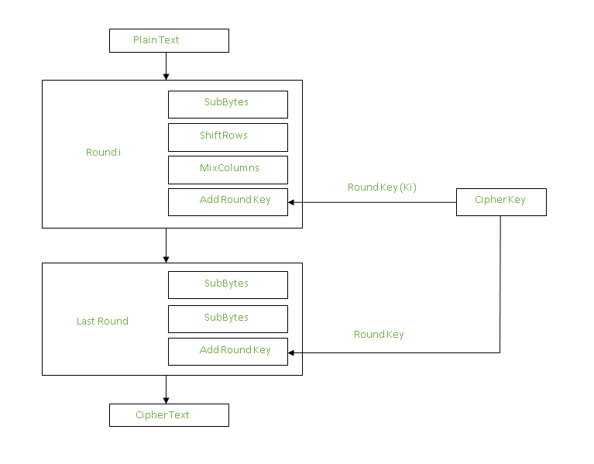
AES ENCRYPTION
Advanced Encryption Standard (AES) is a specification for the encryption of electronic data established by the U.S National Institute of Standards and Technology (NIST) in 2001. AES is widely used today as it is a much stronger than DES and triple DES despite being harder to implement.
AES performs operations on bytes of data rather than in bits. Since the block size is 128 bits, the cipher processes 128 bits (or 16 bytes) of the input data at a time

Slide 35
METHODOLOGY AND MATERIALS USED:
This stage highlights the usability of the proposed system. During this stage, the system is evaluated while user satisfaction is ensured.
The test was executed on the proposed system by running it on Google chrome using the localhost server.
The students were first briefed on the prototype’s usage and the user interface. The usability of the proposed system was also determined.
As can be construed by the result, a significant amount of users agrees that the system is practical, useful and fulfills the project’s primary objective

Slide 36


Slide 37
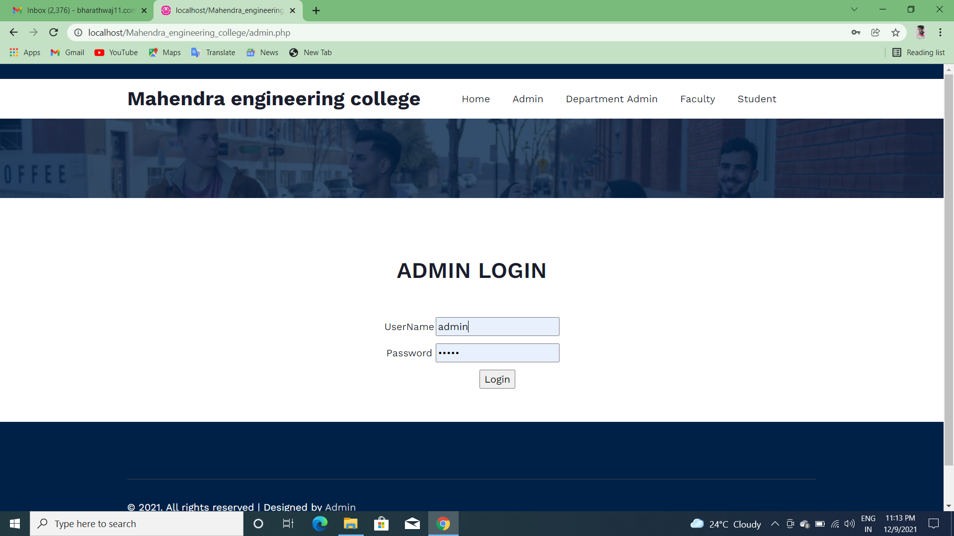
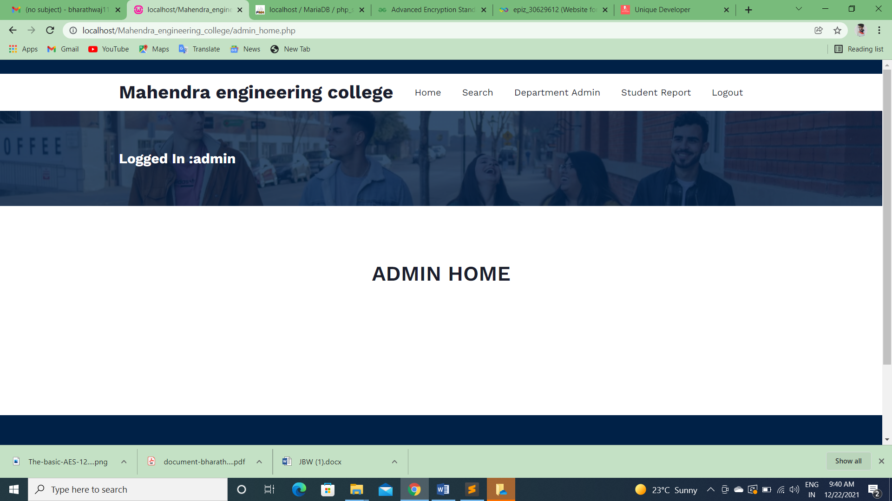

Slide 38
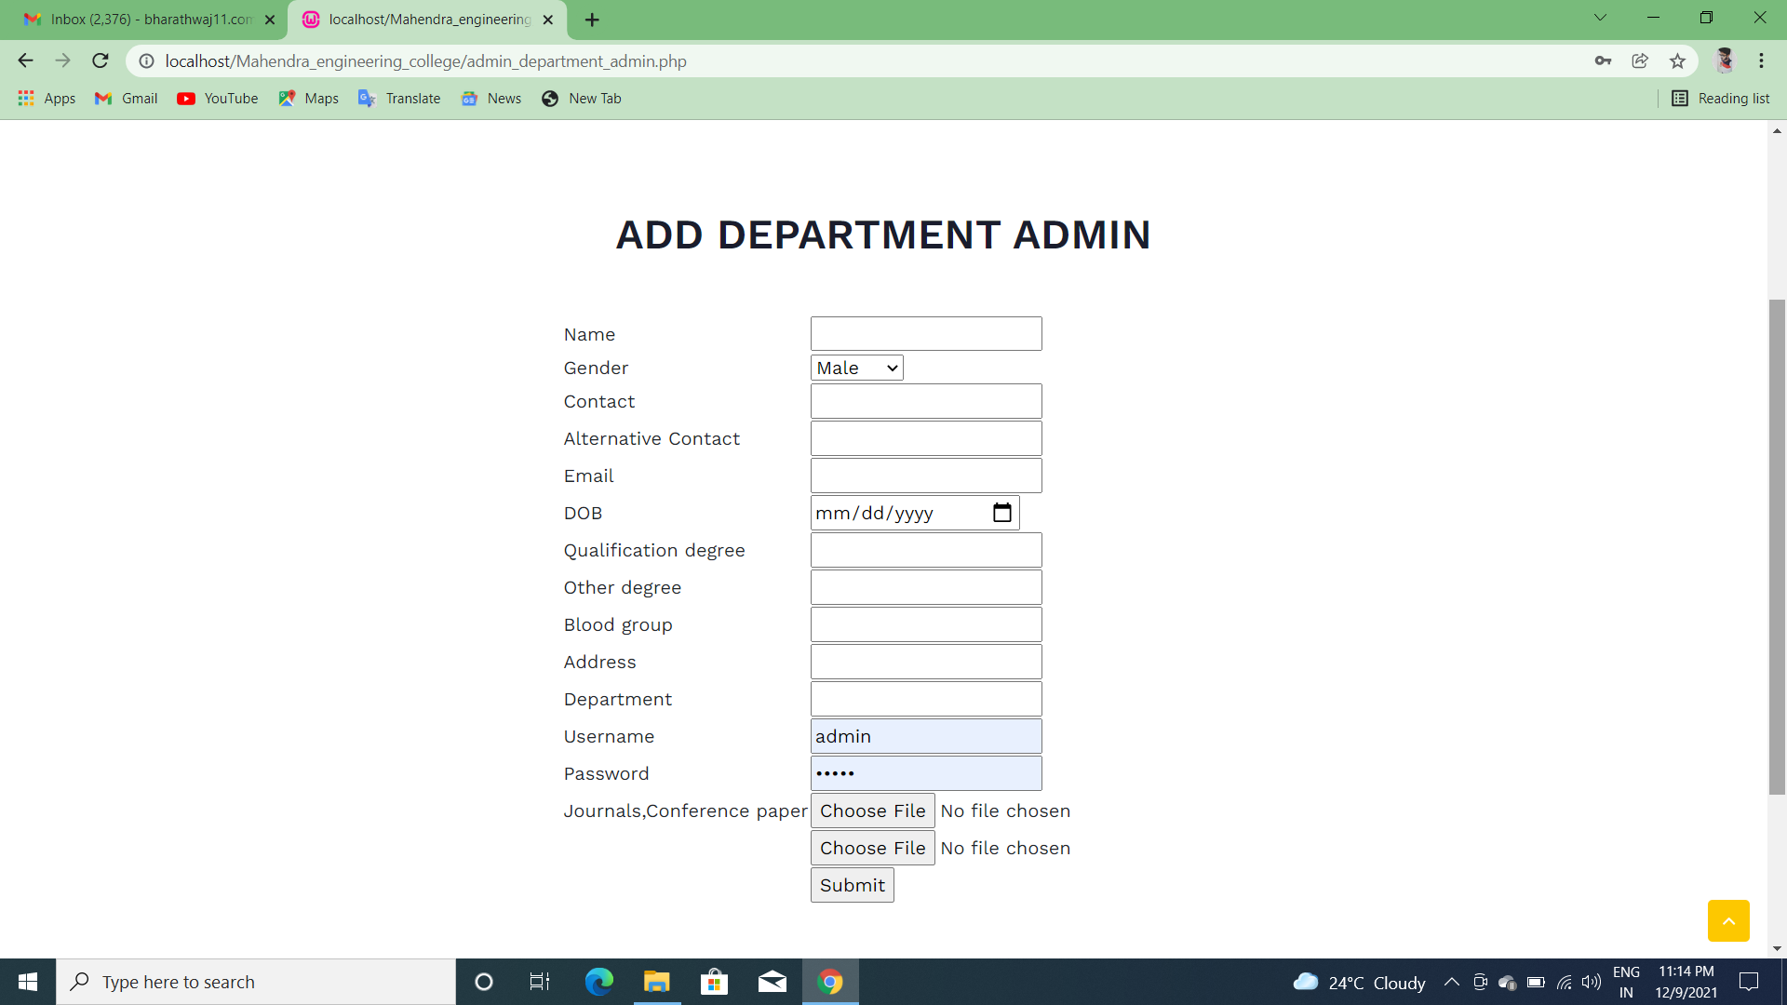
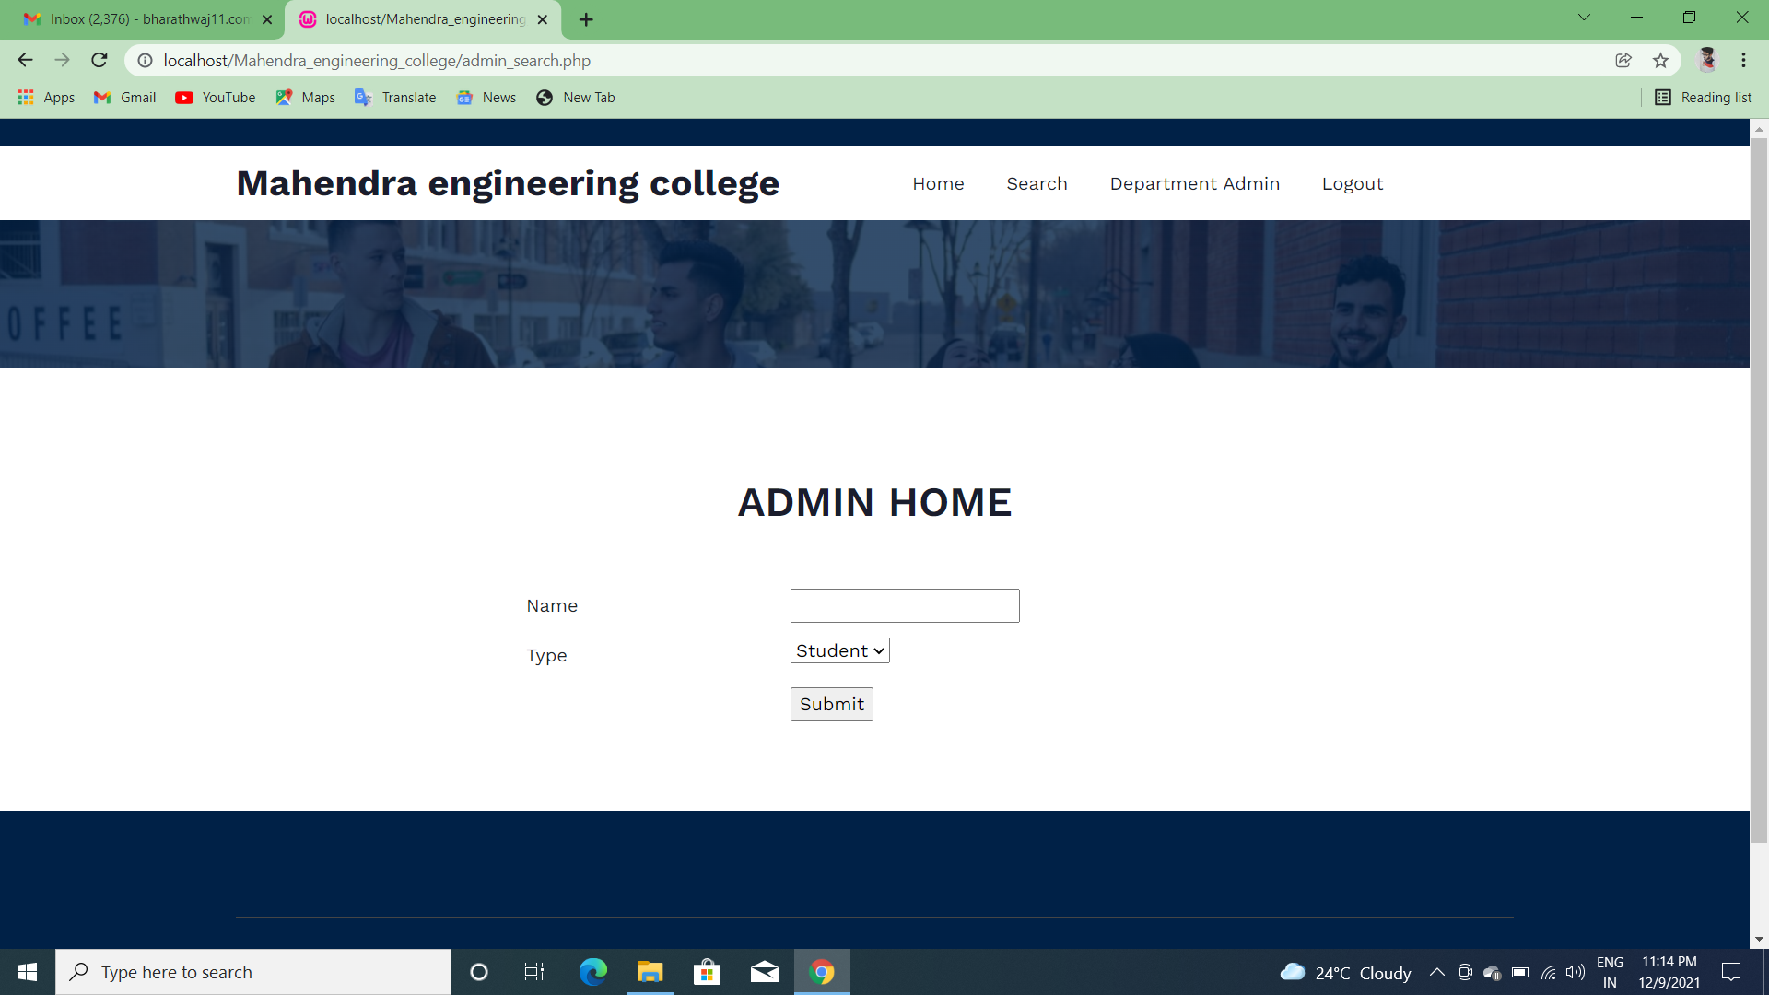

Slide 39

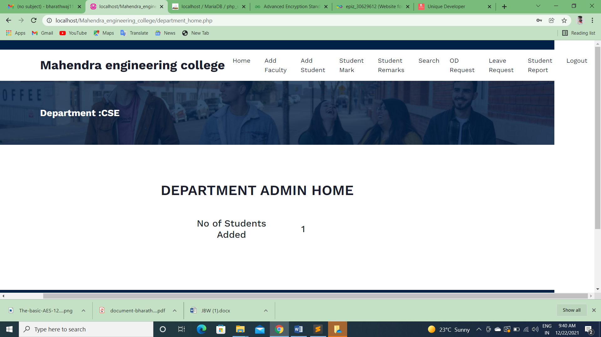

Slide 40
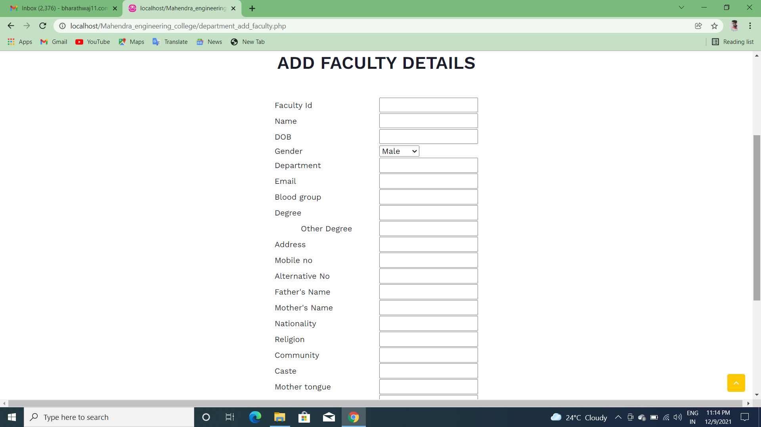
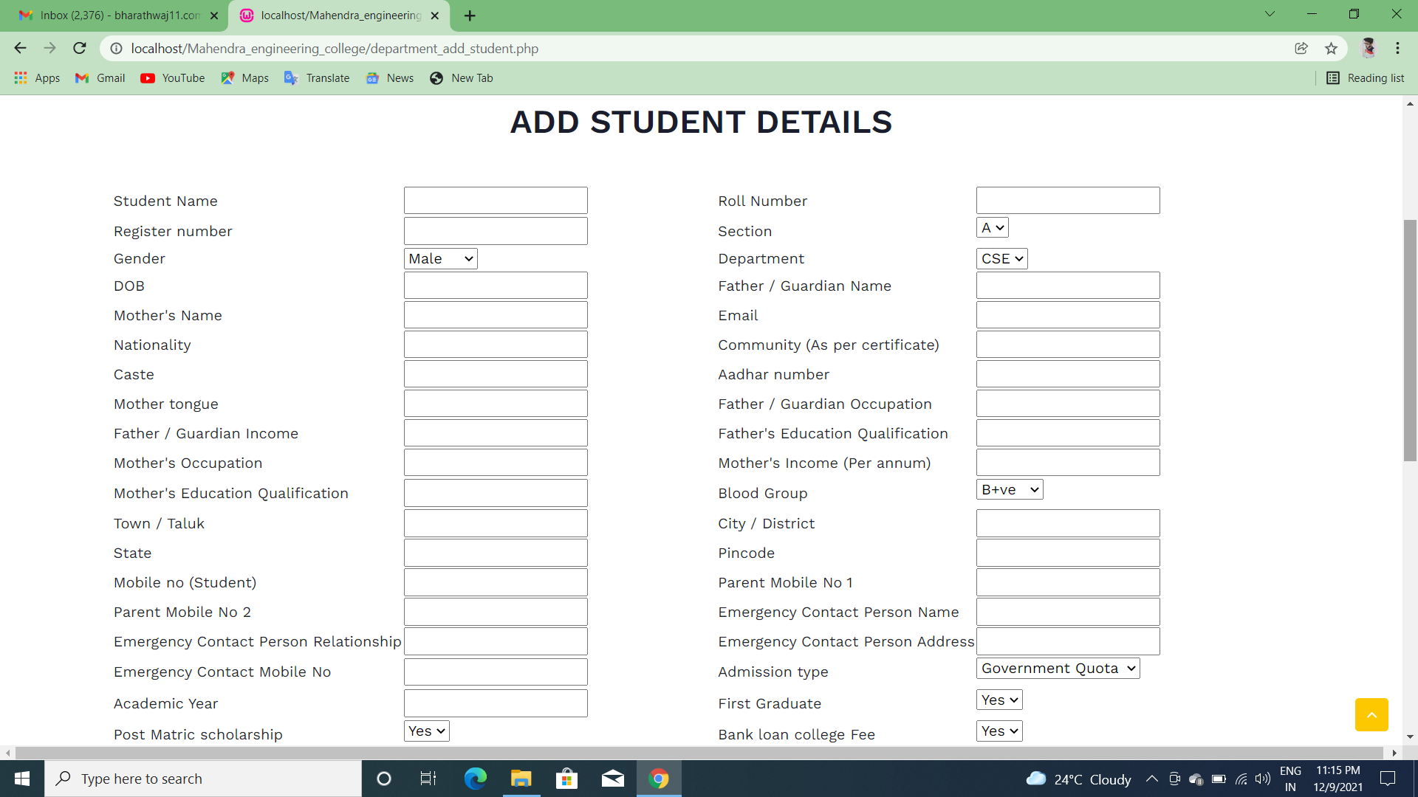

Slide 41
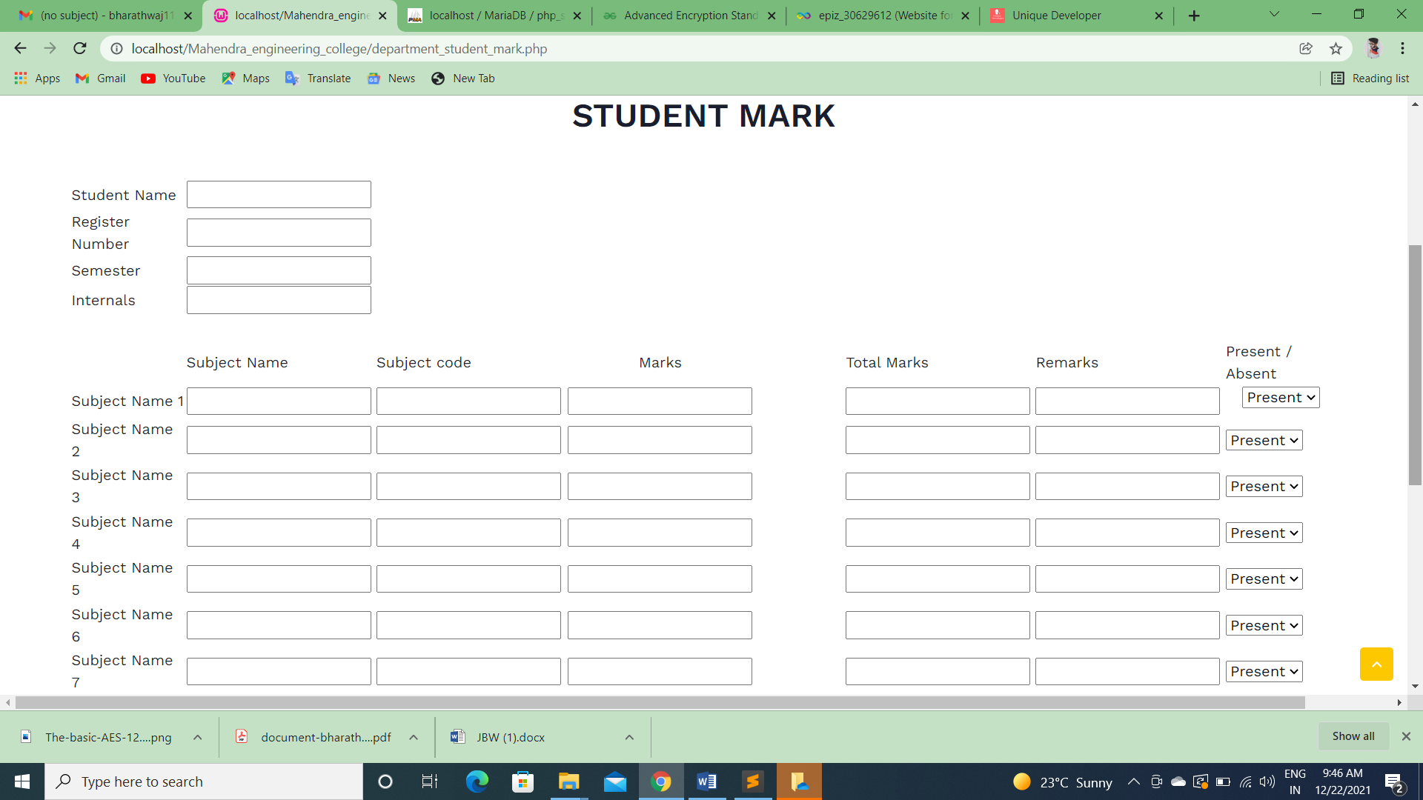
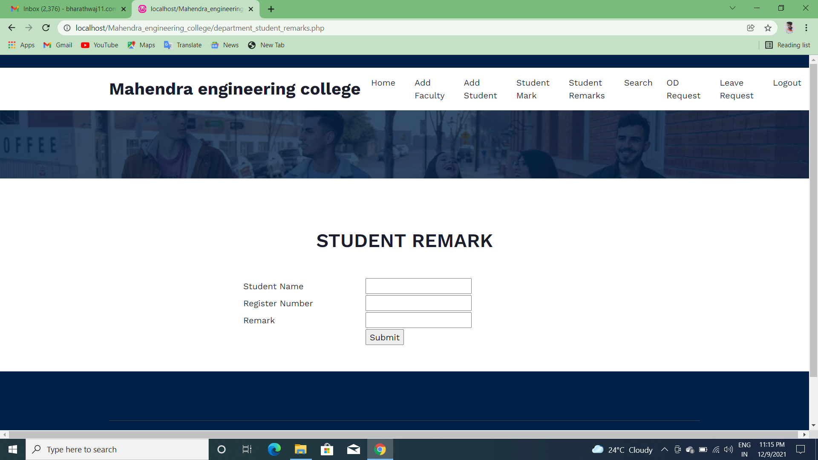

Slide 42
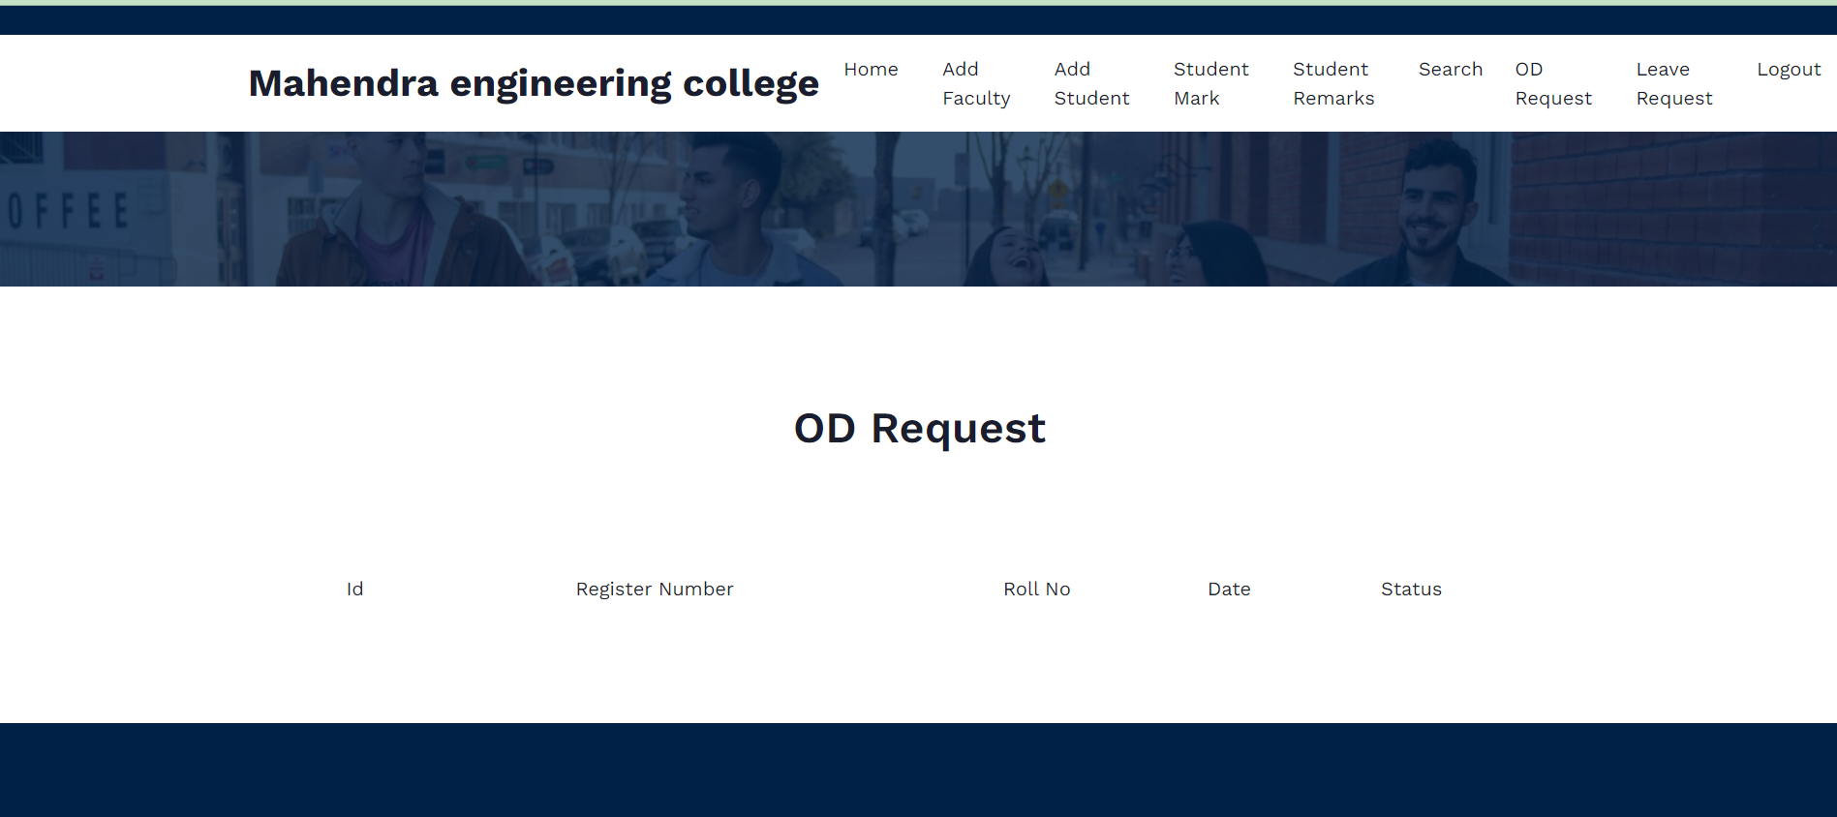

Slide 43
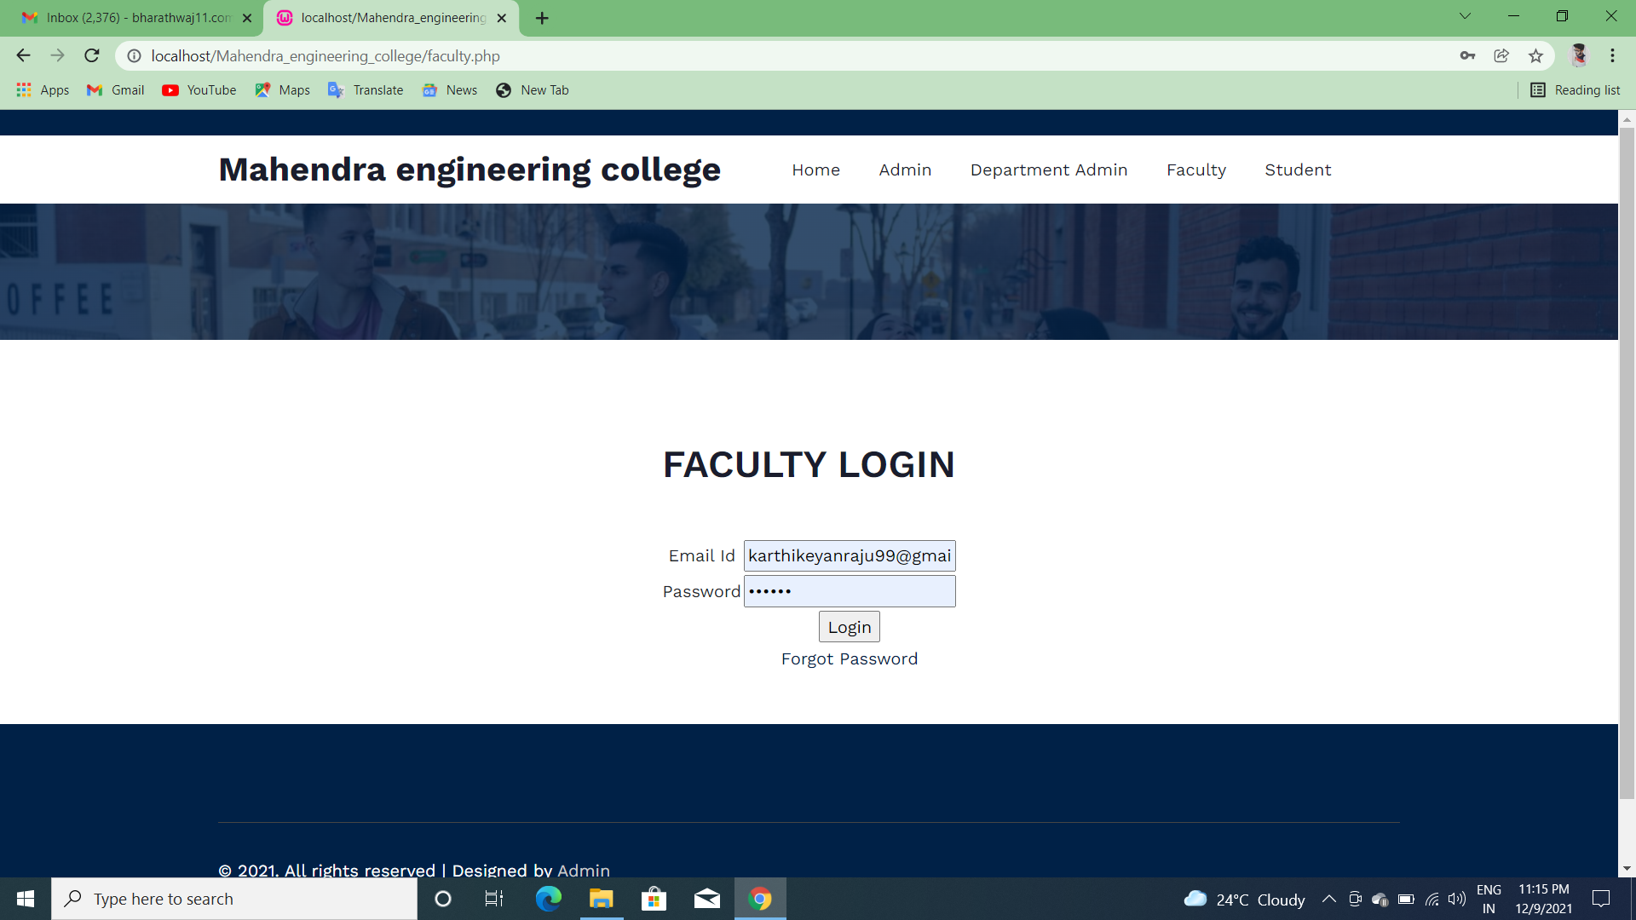
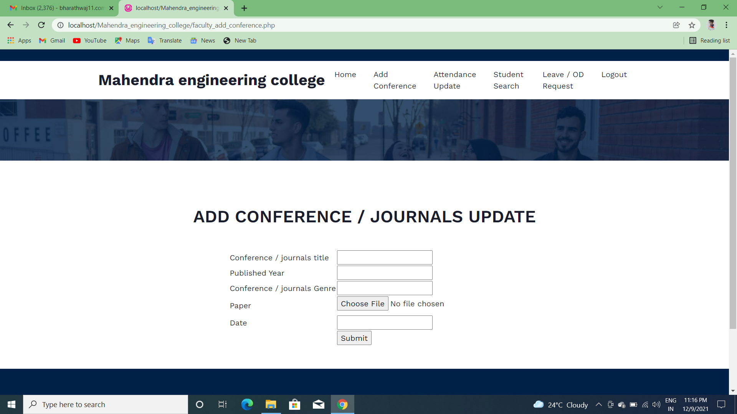
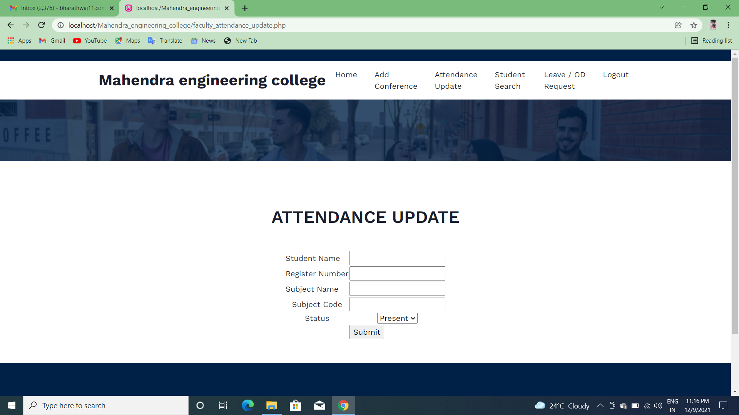
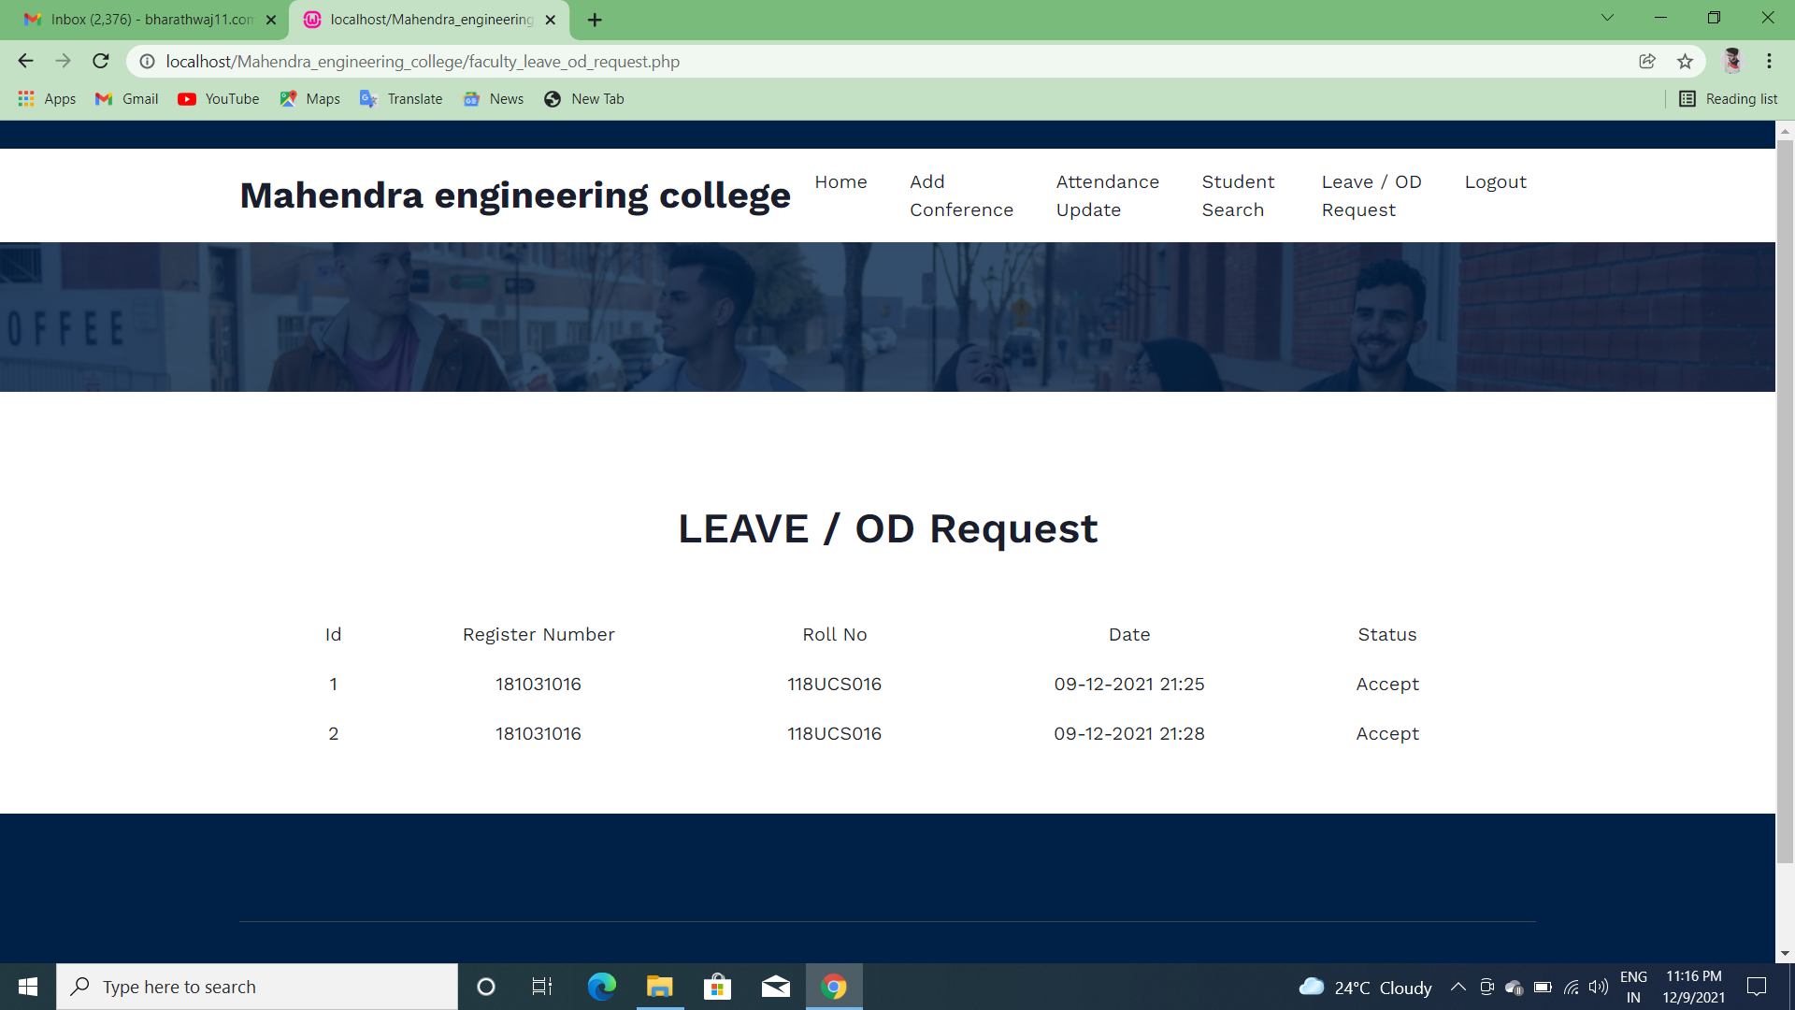

Slide 44
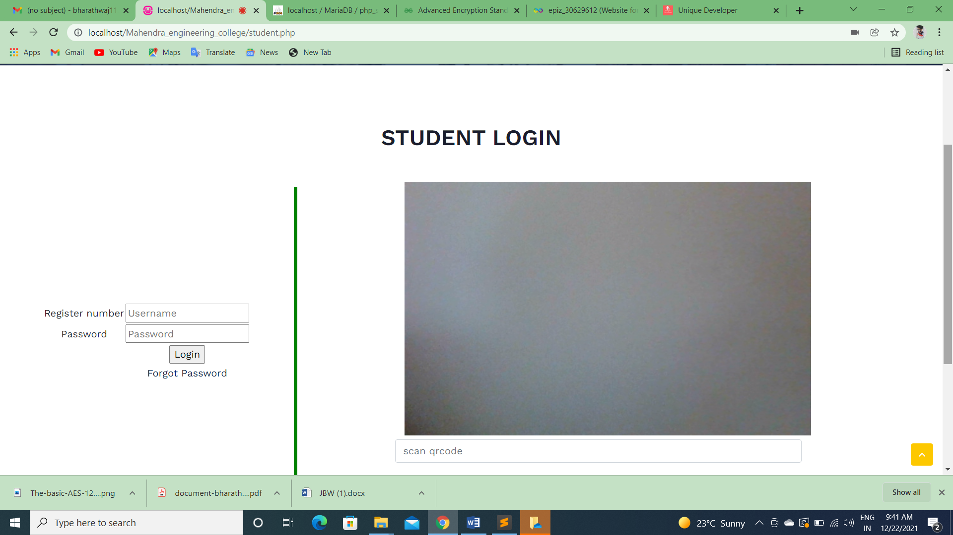

Slide 45
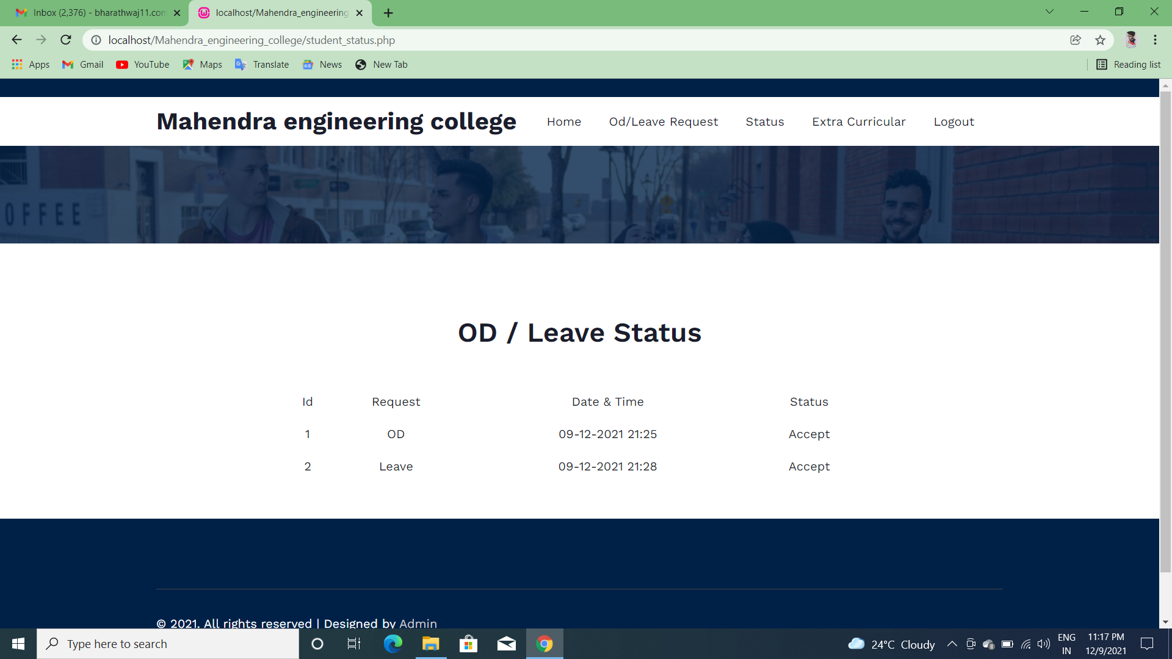
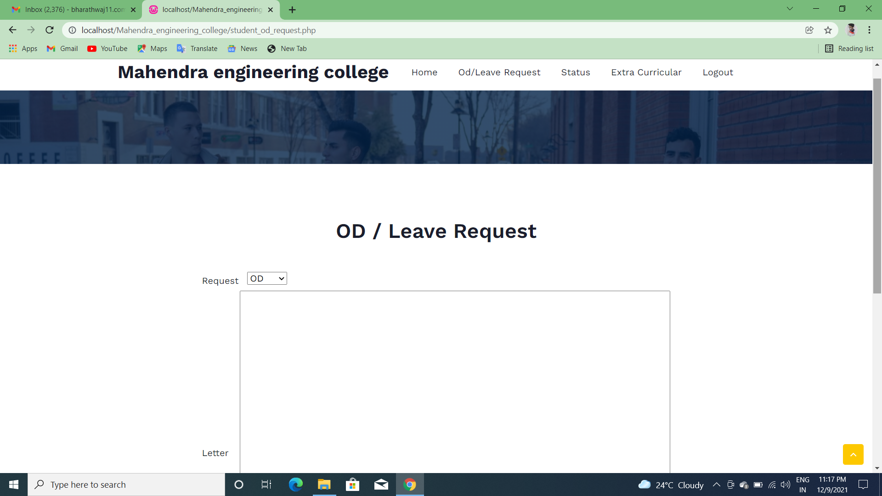
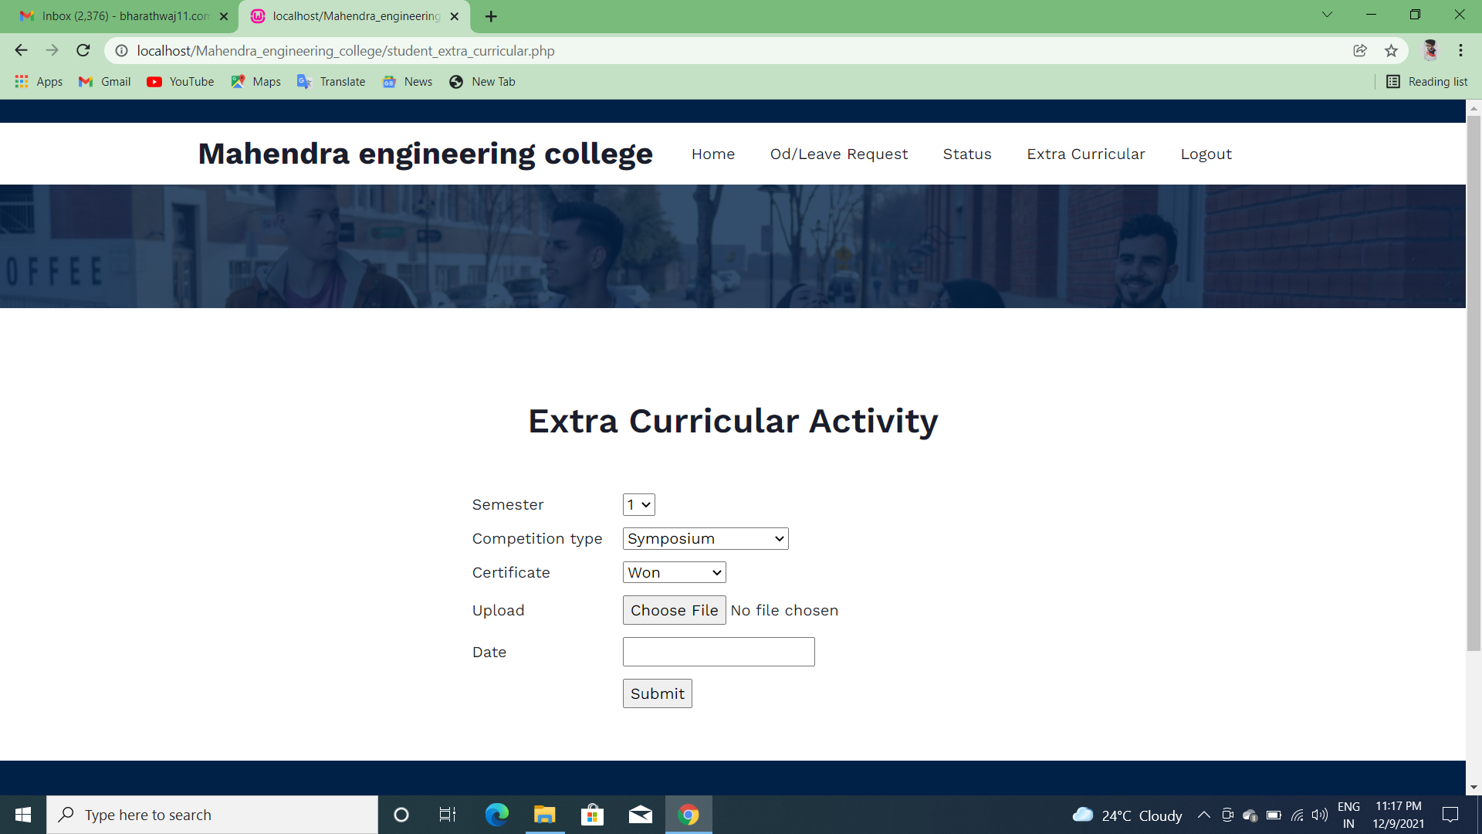

Slide 46
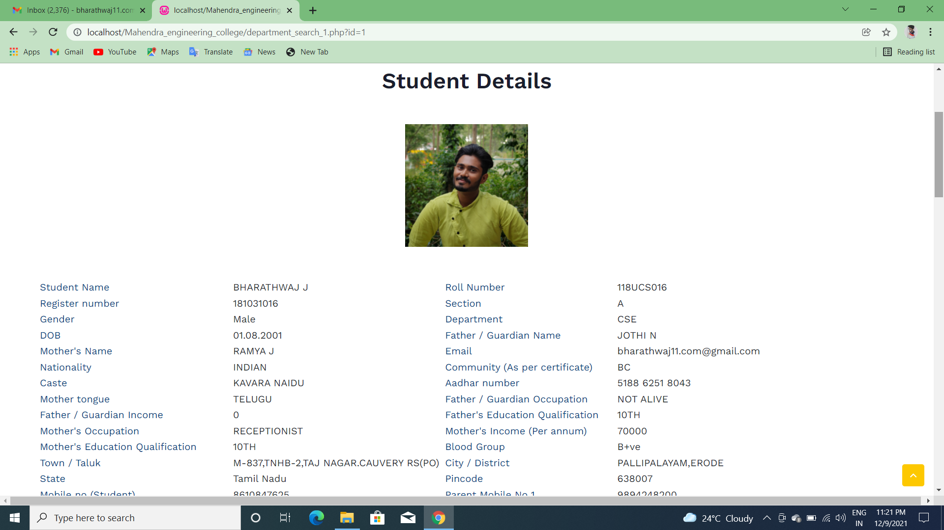
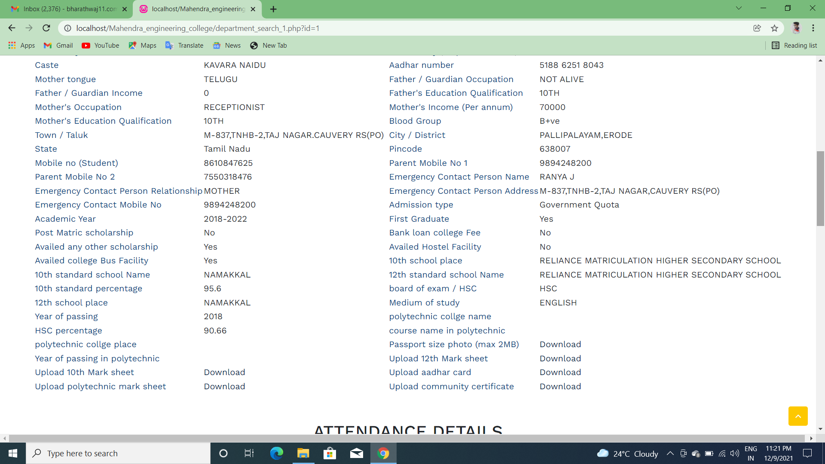

Slide 47
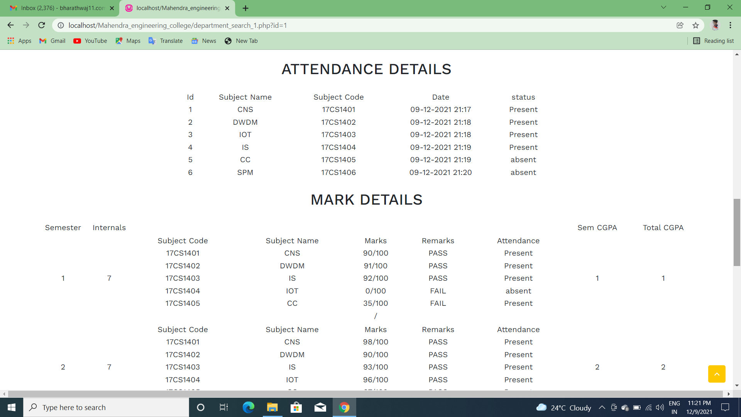
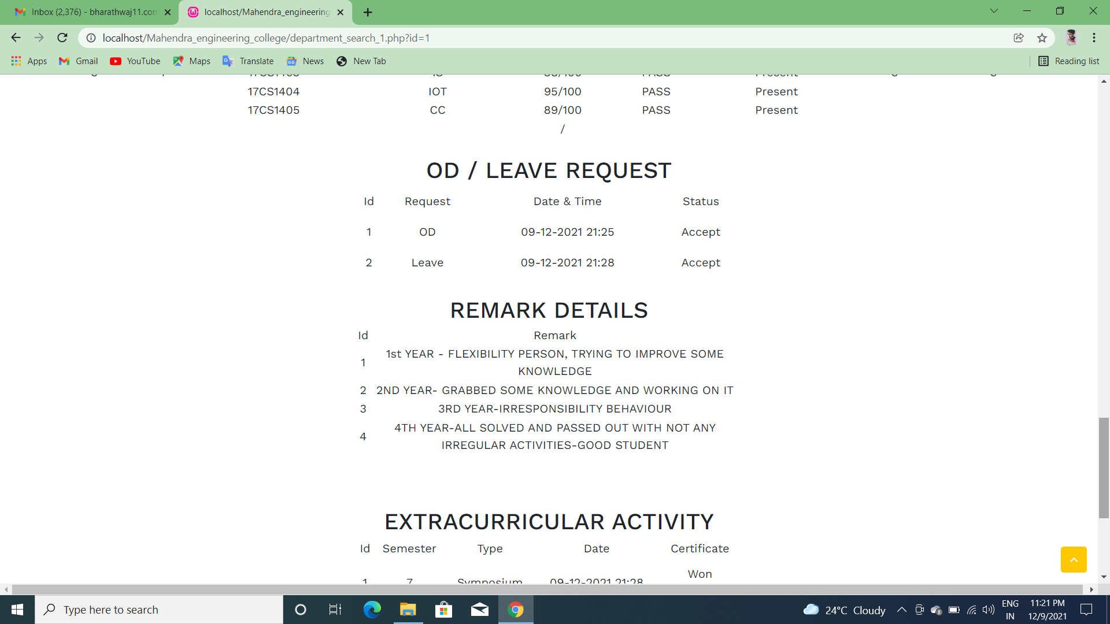
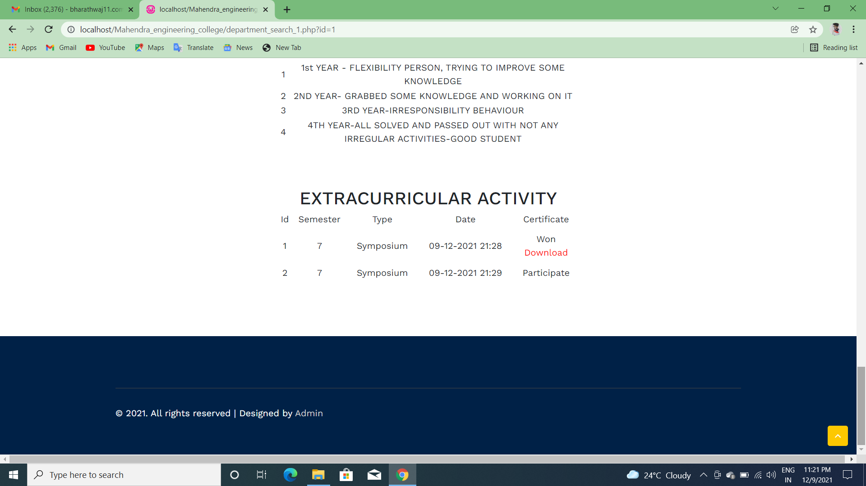

Slide 48
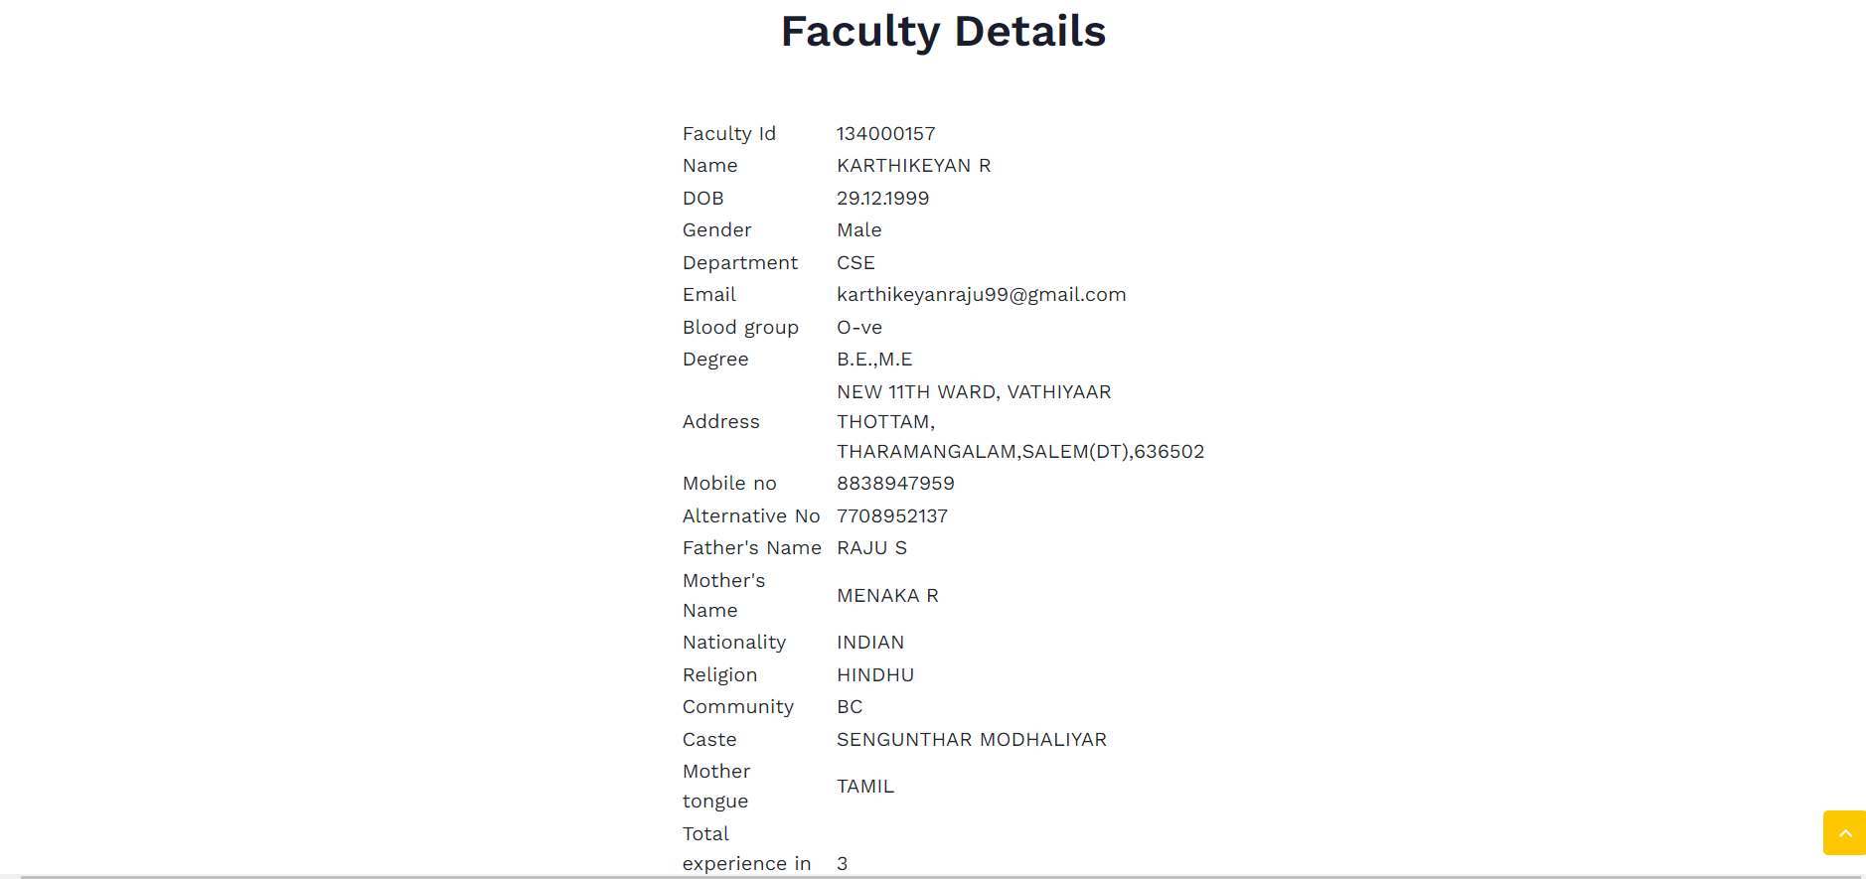

Slide 49

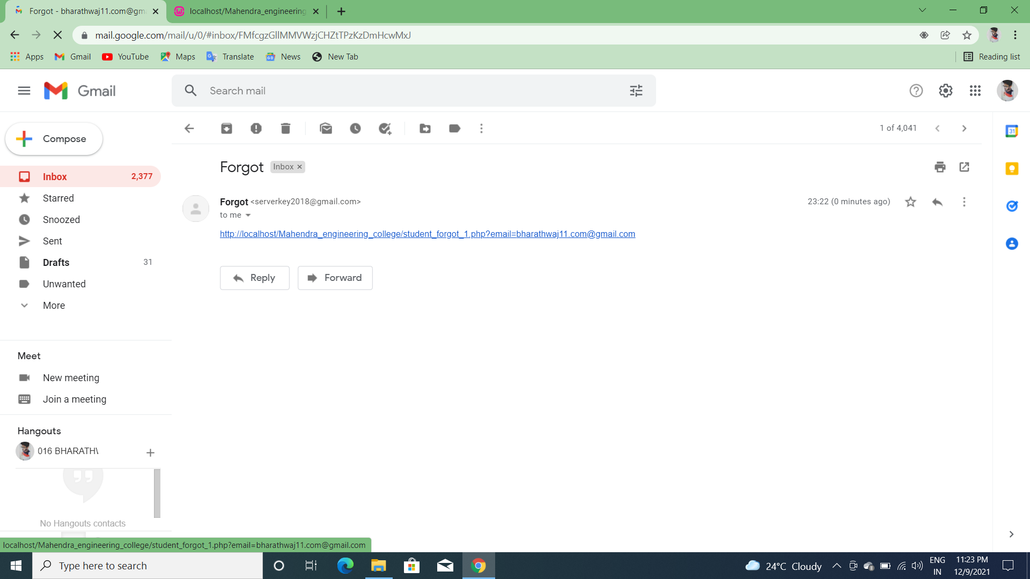


Slide 50
CONCLUSION
The basic goal of designing student information management database system is the database application system that is directed towards the evaluation content of students’ work under office and departmental target responsibility system.
In order to implement the function of student information management, we designed the functional requirement, overall structure, data sheets and fields, data sheet Association and software codes in this paper.
Having a web based front end removes the requirement of users having to understand and use a database directly, and allows users to connect from anywhere with an internet connection and a basic web browser.

Slide 51
FUTURE SCOPE
In future web portal can be combined with the university internal and external web sites. So that all courses in the university will have single web app.
Students can directly fill a resume forum system will use artificial intelligence and sent the resume to companies as per student requirement and eligibility criteria
The present system may be further upgraded in future even maintain the activities in hostel like hostel mess bill and attendance system even in hostels.
By using artificial intelligence the web portal may track the usage of Wi-Fi based on the students registered device.

Slide 52
REFERENCES:-
Febri Liantoni, Septiyawan Rosetya, and Weny M Rahmawati. 2019. The Implementation of QR-Code Technology on Bulak Fish Center Information System. Jurnal Online Informatika 3, 2 (2019), 123–127.
Yu-Cheng Lin, Weng-Fong Cheung, and Fu-Cih Siao. 2014. Developing mobile 2D barcode/RFID-based maintenance management system. Automation in construction 37 (2014), 110–121.
U Narmadhaa, P Pavithra, M Tharuneswari, and S Sowmiya. 2017. Enhanced QR-Code based Application for Library. 3, 1 (2017), 4.
Wasim Rahaman. 2016. Enhancing library services using barcode, Qr code and rfid technology: a case study in Central library national institute of technology, Rourkela. International Journal of Digital Library Services 6, 3 (2016), 39–50.
Ankit Singhal and RS Pavithr. 2015. Degree Certificate Authentication using QR Code and Smartphone. International Journal of Computer Applications 120, 16 (2015).

